Slide 1
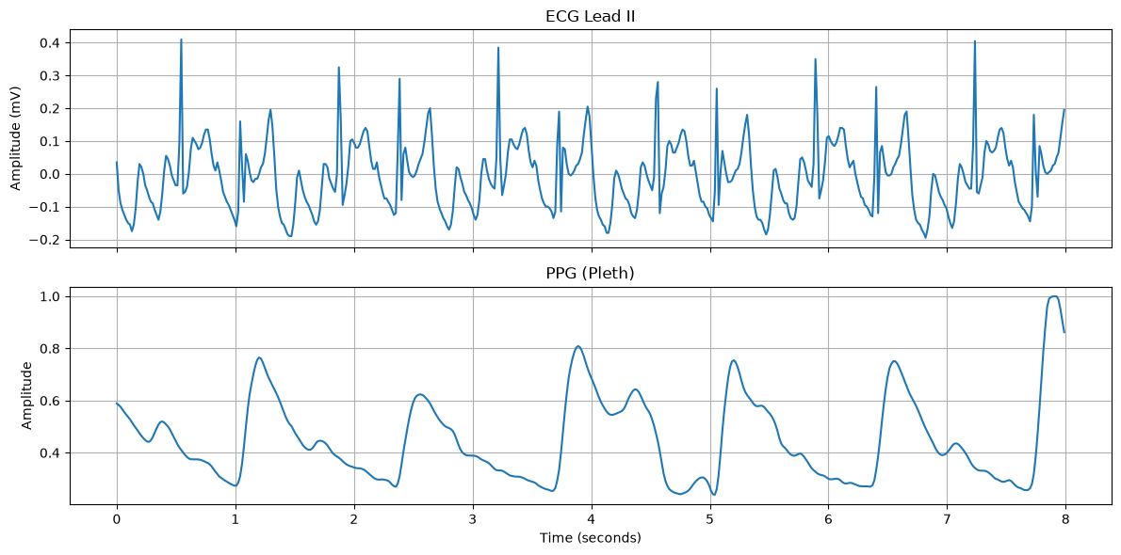
COURSE PROJECT
ECG & PPG
Signal Processing
Wavelet analysis and denoising
How can we reduce noise while preserving important waveform features?
Course: Foundation of Data Science
Presented by: Ridhi Singh
Professor: Dr. Anurag Singh
Under the guidance of: Om Nath Sir
Notes:
Opening: This is our Foundation of Data Science course project on ECG and PPG signal processing. I will explain why we use wavelet analysis, how we examined one selected record, how we compared denoising methods, and what we learned when repeating the analysis across ten records.

Slide 2
Why wavelets for ECG and PPG?
INTRODUCTION
These are non-stationary signals: their shape and frequency content can change over time
Conventional filtering
Wavelet analysis
Keeps a chosen frequency band and discard the rest. It can reduce known interference, but useful ECG or PPG details in the same band may also be reduced.
Looks at the signal at multiple scales while retaining time-local information. DWT gives scale coefficients; CWT shows time-frequency activity. Thresholding can reduce selected coefficients before reconstruction.
The real-world problem
Movement, muscle activity, changes in electrode or sensor contact, and baseline drift can disturb a recording. Our goal is to reduce unwanted disturbance while preserving ECG QRS/R-peaks, PPG pulse shape, and timing.
Notes:
Explain why we use wavelets rather than relying only on a global Fourier transform. ECG and PPG are non-stationary or time-varying: their waveform shapes and frequency content can change during a short recording. Patient movement, electrode or sensor contact changes, muscle activity and baseline drift can introduce unwanted components. A basic Fourier transform summarizes overall frequency content but does not localize a transient in time. The short-time Fourier transform provides timing, but uses a fixed window and trades time resolution against frequency resolution. Wavelets offer a multiresolution view: DWT represents the signal in approximation/detail scales, while CWT visualizes how activity changes over time and frequency. Conventional filters are still useful, but a chosen passband may also attenuate genuine signal content. Important caution: wavelets do not automatically know what is real physiology and what is artifact; threshold choice and waveform-preservation checks are essential. Our goal is not merely to make the plot smoother, but to reduce noise while preserving useful morphology and timing.

Slide 3
First: what do ECG and PPG look like?
SINGLE RECORD
We started by plotting the two channels from the same selected recording
ECG — electrical
Shows electrical activity associated with the heartbeat. Sharp QRS/R peaks are useful landmarks.
PPG — optical pulse
Measures peripheral blood-volume changes. The waveform is smoother and pulse-shaped.
Same time window, different physiological information.
Notes:
This is the first output and a good place to orient the audience. The top panel is ECG Lead II and the bottom panel is PPG Pleth. The x-axis is time in seconds. ECG has sharp electrical deflections, including large QRS-related peaks; PPG has a slower pulse contour with rising and falling portions. Amplitude units should be interpreted according to the channel metadata and how the waveform was loaded. These are not identical signals, and we should not expect their shapes to match.

Slide 4
Our complete workflow
WORKFLOW
This is the road map — next, I will zoom into each part
1. Select record + 8-second window
2. Extract ECG Lead II + PPG Pleth
3. Plot raw signals + basic checks
Then the work splits into three connected analyses
DWT
Approximation + detail coefficients
CWT
Time–frequency scalograms
Denoising
Butterworth + wavelet thresholds
Energy distribution + entropy
Compare Morlet and Mexican Hat
Hard / soft / BayesShrink
Reconstruct and align signal length
Evaluate: RMSE, MAE, SNR, PRD, correlation, peaks
Repeat selected steps across 10 records
Compare records and investigate unusual signal behaviour
Notes:
Walk through this once without diving into details. We select and validate the signals, then split into multiscale analysis, time-frequency visualization, and denoising comparisons. We reconstruct or align the processed output, calculate metrics and inspect peaks, then repeat selected steps across ten records. The flowchart is a conceptual map; CWT, DWT feature analysis, and denoising are connected analyses, not necessarily a single linear chain.

Slide 5
Road map, part 1: get the data right
WORKFLOW ZOOM
Start from one file before automating the steps
1. Select record + 8-second window
2. Extract ECG Lead II + PPG Pleth
3. Plot raw signals + basic checks
Then the work splits into three connected analyses
DWT
Approximation + detail coefficients
CWT
Time–frequency scalograms
Denoising
Butterworth + wavelet thresholds
Energy distribution + entropy
Compare Morlet and Mexican Hat
Hard / soft / BayesShrink
Reconstruct and align signal length
Evaluate: RMSE, MAE, SNR, PRD, correlation, peaks
Repeat selected steps across 10 records
Compare records and investigate unusual signal behaviour
What I check here: correct channels • segment length • missing/non-finite values • plausible waveform range
Notes:
The first section covers data handling. We choose one waveform record, extract ECG Lead II and PPG Pleth from our selected interval, then plot them. Basic checks include signal length, finite values and amplitude range. We do this before interpreting wavelet coefficients because incorrect data loading would make every later result unreliable.

Slide 6
Road map, part 2: analyse and process
WORKFLOW ZOOM
Different tools answer different questions
1. Select record + 8-second window
2. Extract ECG Lead II + PPG Pleth
3. Plot raw signals + basic checks
Then the work splits into three connected analyses
DWT
Approximation + detail coefficients
CWT
Time–frequency scalograms
Denoising
Butterworth + wavelet thresholds
Energy distribution + entropy
Compare Morlet and Mexican Hat
Hard / soft / BayesShrink
Reconstruct and align signal length
Evaluate: RMSE, MAE, SNR, PRD, correlation, peaks
Repeat selected steps across 10 records
Compare records and investigate unusual signal behaviour
DWT = coefficients across scales • CWT = activity over time and frequency • Denoising = modify and reconstruct
Notes:
This slide highlights the analysis branches. DWT gives us approximation and detail coefficients and supports energy/entropy summaries. CWT creates scalograms that show time-frequency activity. Denoising uses either conventional filtering or wavelet coefficient thresholding. We compare methods rather than assuming all of them have the same objective.

Slide 7
Road map, part 3: evaluate, then scale up
WORKFLOW ZOOM
A result is useful only if we can explain how it was measured
1. Select record + 8-second window
2. Extract ECG Lead II + PPG Pleth
3. Plot raw signals + basic checks
Then the work splits into three connected analyses
DWT
Approximation + detail coefficients
CWT
Time–frequency scalograms
Denoising
Butterworth + wavelet thresholds
Energy distribution + entropy
Compare Morlet and Mexican Hat
Hard / soft / BayesShrink
Reconstruct and align signal length
Evaluate: RMSE, MAE, SNR, PRD, correlation, peaks
Repeat selected steps across 10 records
Compare records and investigate unusual signal behaviour
Metrics + peak checks + record-by-record inspection = a stronger conclusion than a smooth-looking line alone
Notes:
This final workflow stage compares the processed waveform to a chosen reference, checks SNR and other metrics, and checks whether detected ECG peaks moved or disappeared. After learning from one record, the same selected experiment is run on ten records. We also inspect unusual cases instead of blindly averaging them into the final answer.

Slide 8
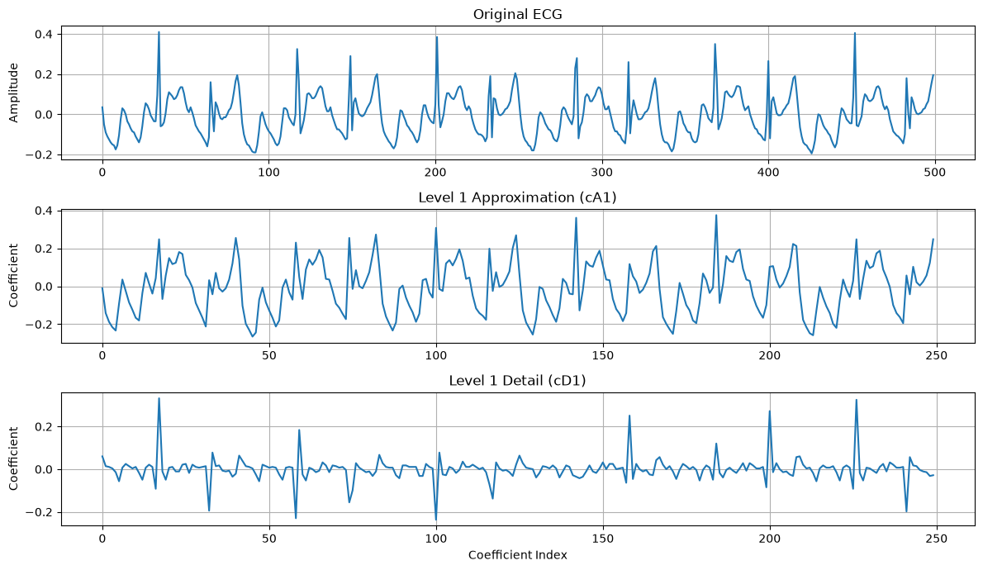
DWT: splitting the signal into approximation and detail
SINGLE RECORD
We used the Haar wavelet first because its calculation is easy to understand
For a pair of samples x₁ and x₂:
A = (x₁ + x₂) / √2
D = (x₁ − x₂) / √2
Approximation (A): combined, coarser information
Detail (D): difference between paired samples
Each level decomposes the approximation again
For a 3-level DWT, the final pieces are A3, D3, D2 and D1.
Notes:
The top of the screenshot is the original ECG, then the first-level approximation and detail. Haar works on pairs of samples. The approximation is a normalized sum and the detail is a normalized difference. The square-root-of-two normalization is the usual orthonormal Haar convention. A3 and D3/D2/D1 are not four unrelated filters; they are the approximation and details from a multilevel decomposition. Detail coefficients can contain both useful sharp changes and noise.

Slide 9
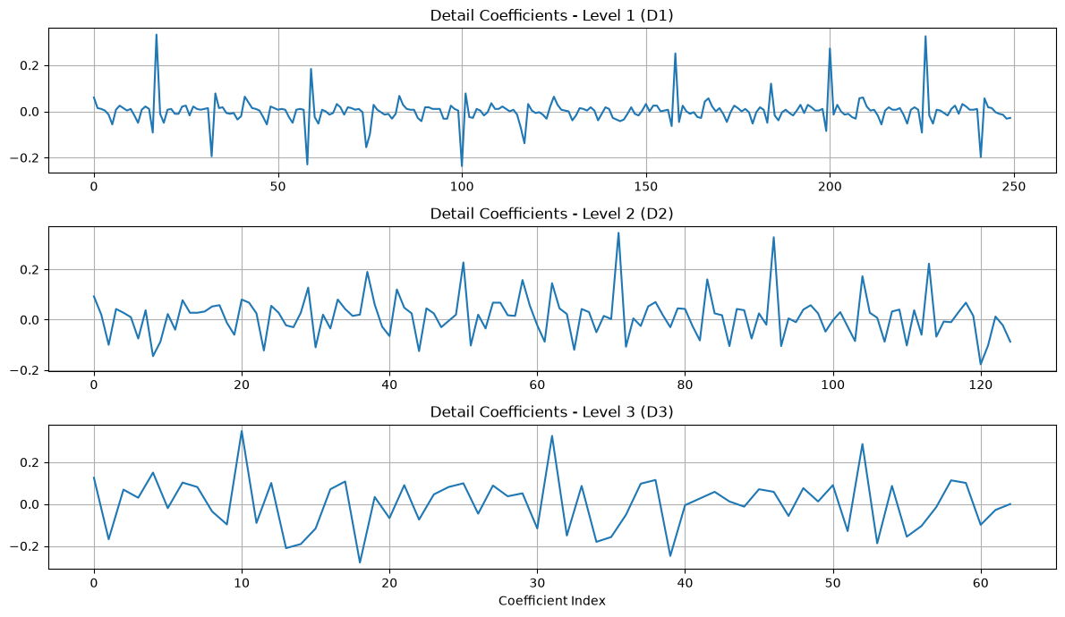
What do D1, D2 and D3 actually show?
DWT
The detail coefficients are different resolutions of the waveform changes
D1 — finest detail
Fastest changes and fine-scale variation.
D2 and D3
Progressively coarser detail patterns.
Important caveat
Sharp physiological features can also appear in details. Detail does not automatically mean noise.
Notes:
These plots show the detail coefficients at the first three levels. D1 is the finest and usually captures rapid, small-scale variation. D2 and D3 summarize changes at coarser scales. Note that the coefficient index is not the original time axis: there are fewer coefficients at coarser levels because the transform downsamples. Avoid describing all details as noise, because QRS complexes or pulse transitions also create sharp changes.

Slide 10
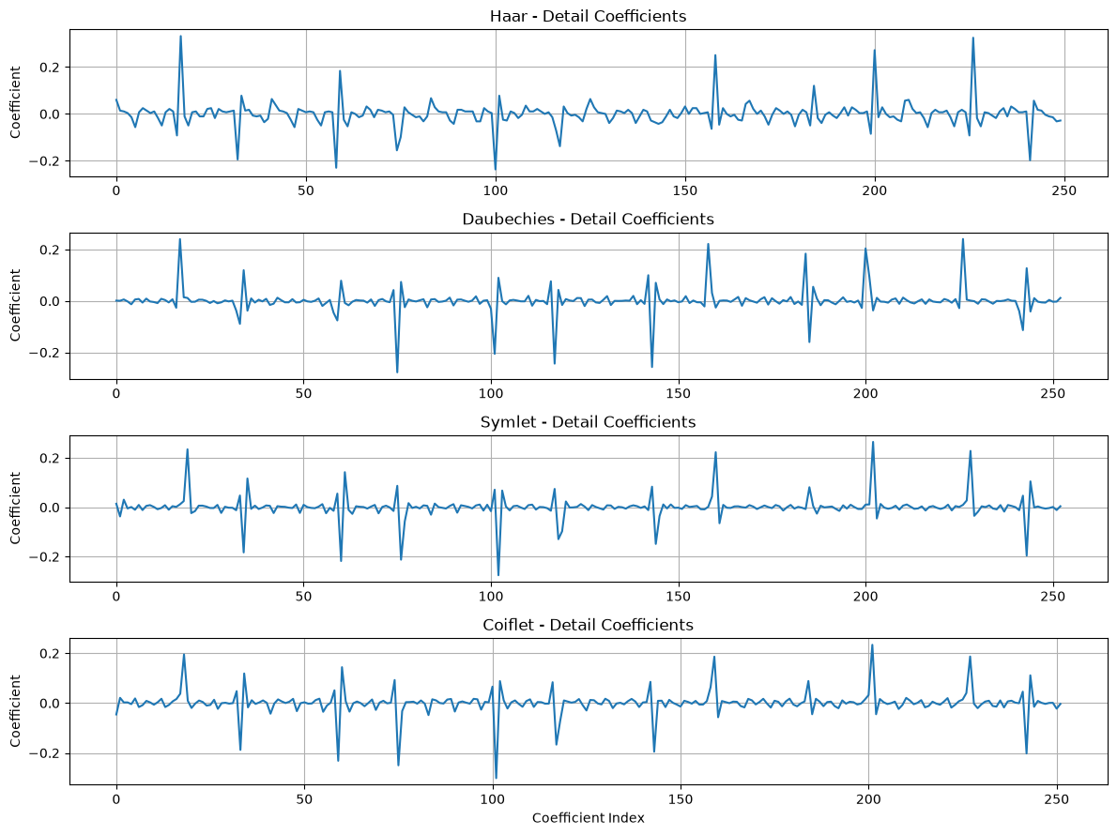
Different wavelet families, different coefficient patterns
DWT
We compared the representation, not just the names
Coefficient-energy values from this run
Haar
0.8166
Daubechies
0.6550
Symlet
0.6401
Coiflet
0.6648
These values depend on the transform and normalization used. They are not the same as relative-energy percentages.
Notes:
The four plots show how Haar, Daubechies, Symlet and Coiflet represent the same ECG segment. They differ in shape, support and response to changes, so the coefficient patterns are not identical. The numbers on the right are the coefficient-energy values supplied for this run: Haar 0.8166, Daubechies 0.6550, Symlet 0.6401 and Coiflet 0.6648. Energy is often calculated as a sum of squared coefficients; direct values can change with wavelet normalization and coefficient handling. Do not interpret these numbers as a universal ranking or confuse them with the percentage distribution on the next slide.

Slide 11
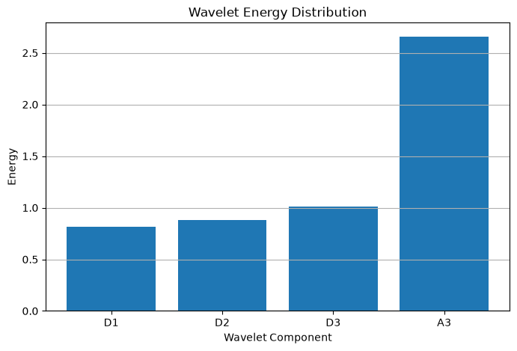
Energy and entropy: what is in each scale?
DWT FEATURES
This is a compact summary of the single-record ECG analysis
Relative wavelet energy
Entropy values
D1
15.20%
D1
4.8191
D2
16.46%
D2
5.2790
D3
18.88%
D3
4.8797
A3
49.47%
A3
5.2521
How to read this
Energy = relative amount of coefficient energy at a scale. Entropy = how the coefficient/energy distribution is spread, according to the formula used.
Here A3 carries the largest share of ECG relative energy (49.47%).
Notes:
The left screenshot is the raw coefficient-energy plot from the notebook; it is not itself the relative percentage chart. The numbers beside it are the relative wavelet-energy percentages supplied from the code: D1 15.20%, D2 16.46%, D3 18.88%, A3 49.47%. Entropy values are D1 4.8191, D2 5.2790, D3 4.8797 and A3 5.2521. Say what formula your code used for entropy if asked. Entropy is not a direct signal-quality or diagnosis score. Together the features summarize how the signal is distributed across the transform components.

Slide 12
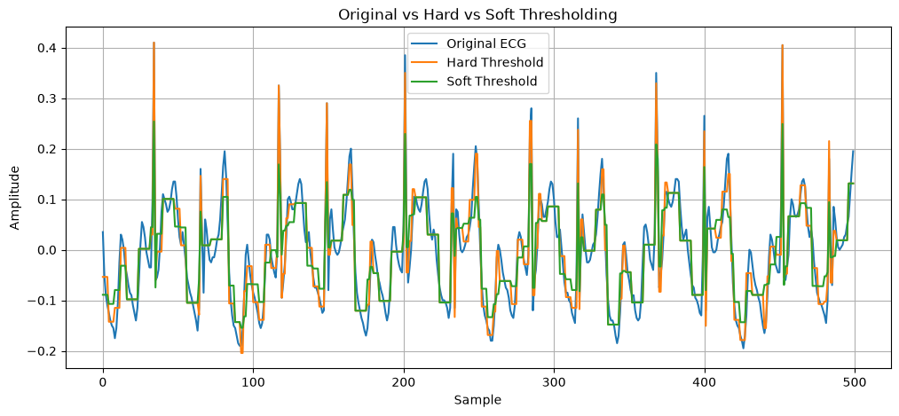
Wavelet denoising: hard vs soft thresholding
DENOISING
The idea is to suppress small coefficients before reconstructing the signal
Hard threshold
Below threshold → 0. Above threshold → keep the coefficient as it is.
Soft threshold
Below threshold → 0. Remaining coefficients are shrunk towards zero.
Both can remove useful detail if the threshold is too strong.
Notes:
Explain the orange hard-threshold curve and green soft-threshold curve relative to the original blue ECG. Hard thresholding makes a sharp decision: retain or zero. Soft thresholding makes the same zeroing decision for small coefficients but shrinks the surviving coefficients too. A lower threshold preserves more details but may leave noise; a higher threshold removes more but can distort true ECG morphology. The output must be reconstructed from the adjusted coefficients to return to the signal domain.

Slide 13
Two different ideas: Butterworth filtering and BayesShrink
DENOISING
One is frequency-based; the other adapts to wavelet coefficients
Conventional: Butterworth band-pass
Wavelet: BayesShrink
• Uses a chosen frequency band (in this run: 0.5–30 Hz, 4th order)
• Discard components outside the passband
• Applied to the waveform directly
• Decomposes signal into scales
• Estimates noise from detail coefficients
• Chooses level-dependent thresholds and uses soft thresholding
Butterworth
BayesShrink
frequency band → filtered signal
coefficients → adaptive threshold → reconstruct
Key difference: Butterworth chooses a frequency band; BayesShrink adapts thresholds across wavelet scales.
Notes:
This comparison helps the audience see that these methods are not doing exactly the same thing. A Butterworth band-pass filter uses selected cutoff frequencies and processes the signal globally in frequency terms. In the shown run it was designed as fourth order, 0.5 to 30 Hz, with forward-backward filtering. BayesShrink works on wavelet coefficients and adapts the threshold for each detail level using a noise and signal variance estimate. Neither method is universally superior. One technical check: at a sampling rate near 62.47 Hz, the Nyquist limit is about 31.24 Hz, so a 30 Hz high cutoff is close to the limit and should be verified.

Slide 14
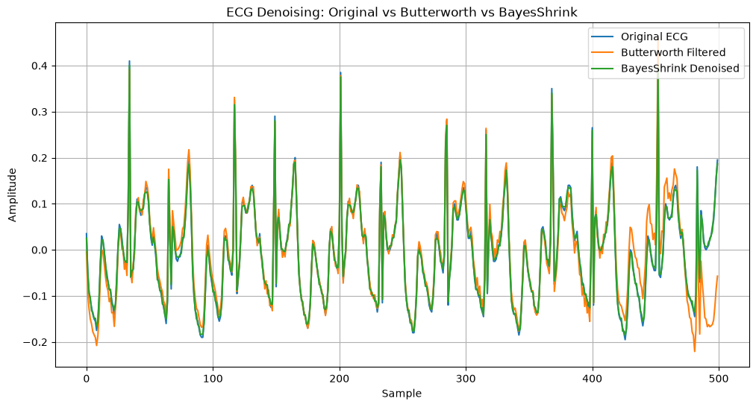
Single-record comparison: Butterworth vs BayesShrink
SINGLE RECORD
For this record, the wavelet-denoised line stays closer to the reference
Butterworth
BayesShrink
RMSE
0.039629
0.006133
MAE
0.021790
0.005369
Correlation
0.928549
0.998432
What the numbers say
Lower RMSE/MAE and higher correlation indicate closer waveform agreement for this selected segment.
This is one segment, not proof that BayesShrink always wins.
Notes:
The graph overlays original ECG, Butterworth-filtered ECG and BayesShrink-denoised ECG. Use the figures supplied for this run: Butterworth RMSE 0.039629, MAE 0.021790, correlation 0.928549; BayesShrink RMSE 0.006133, MAE 0.005369, correlation 0.998432. Lower error means the output remains closer to the recorded reference; higher correlation means stronger similarity of waveform variation. This is specific to the selected record, reference and filter/threshold settings.

Slide 15
Did denoising move the important peaks?
SINGLE RECORD
We checked detected peak positions, not just the visual smoothness
Original ECG
After BayesShrink
Position differences
12 peaks detected
12 peaks detected
[0, 0, 0, 0, 0, 0, 0, 0, 0, 0, 0, 0]
Original peak positions
[34, 81, 117, 149, 201, 248, 285, 316, 368, 400, 452, 483]
BayesShrink peak positions
[34, 81, 117, 149, 201, 248, 285, 316, 368, 400, 452, 483]
Morphological correlation: 0.998432 • peak positions matched in this segment
Notes:
The peak detector was run on both the original and the BayesShrink signal using the same settings. Both found twelve peaks, and the positions were exactly the same: 34, 81, 117, 149, 201, 248, 285, 316, 368, 400, 452 and 483. The differences were all zero samples. The reported morphological correlation was 0.998432. This supports preservation of these detected peaks for this segment, but it does not guarantee that every subtle ECG feature is unchanged or that performance transfers to every record.

Slide 16
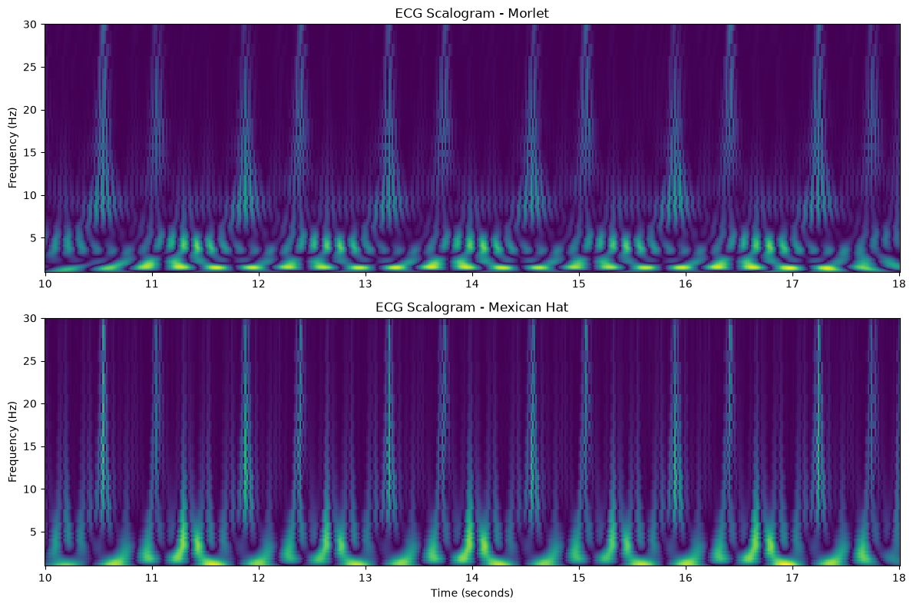
CWT: see how signal activity changes over time
CWT
We compared Morlet and Mexican Hat scalograms for the ECG segment
Morlet
Oscillatory wavelet; useful for following broader time-frequency patterns and oscillatory structure.
Mexican Hat
More localized, peaked response; can emphasize transient changes and sharp features.
Neither is automatically “better” — the representation depends on the feature we want to see.
Notes:
This slide introduces the continuous wavelet transform. Each scalogram shows how wavelet coefficient magnitude varies with time and frequency. The y-axis is frequency in Hz, and the x-axis is time from the selected record. Brighter regions correspond to larger coefficient magnitudes. Morlet has an oscillatory shape and can show oscillatory patterns across time-frequency space. Mexican Hat is more localized around waveform features. These are different views of the same signal and the better choice depends on the question. The notebook’s plotted frequency range approaches the Nyquist limit at its upper edge, so interpret the highest frequencies cautiously.

Slide 17
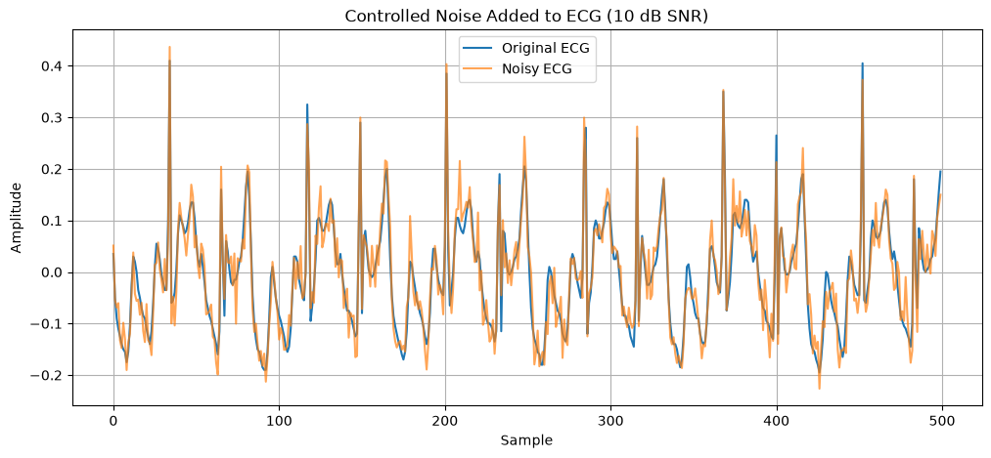
Controlled noise: create a repeatable test
CONTROLLED-NOISE EXPERIMENT
We deliberately added Gaussian noise to the ECG before denoising
Original ECG
Reference waveform from the selected segment.
Noisy ECG
Original + synthetic Gaussian noise.
Target SNR: 10 dB
This is a controlled experiment, not a simulation of every real-world artifact.
Notes:
Explain why noise was added: it gives us a repeatable setting where the original recorded ECG is retained as a reference and the added noise is known. The target SNR was 10 dB. This lets us compare noisy and denoised signals with the same baseline. Real artifacts can include motion, baseline wander, muscle activity and sensor effects, and Gaussian noise does not mimic all of them.

Slide 18
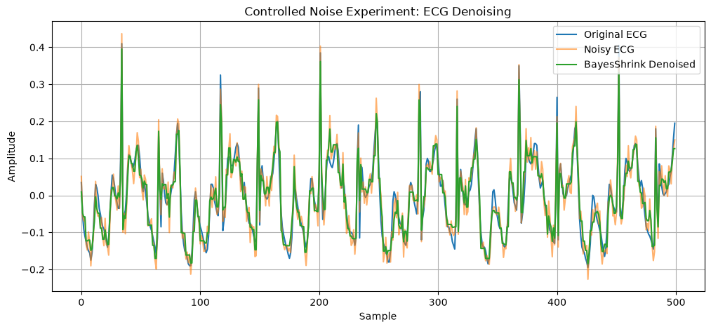
After BayesShrink: did the controlled-noise result improve?
CONTROLLED-NOISE EXPERIMENT
We compare the noisy and denoised traces against the original reference
SNR
Before 10.17 dB
After 10.88 dB
+0.71 dB improvement
Metric
Noisy
Denoised
RMSE
0.031927
0.029428
MAE
0.025379
0.023137
NRMSE
0.052773
0.048641
PRD
31.00%
28.57%
Correlation
0.954355
0.958178
Errors fall slightly; correlation rises slightly. Improvement is measurable, but modest.
Notes:
Use the metrics the user supplied for this controlled-noise output. SNR before is 10.17 dB and after is 10.88 dB, so the improvement is +0.71 dB. RMSE drops from 0.031927 to 0.029428, MAE from 0.025379 to 0.023137, NRMSE from 0.052773 to 0.048641, and PRD from 31.00% to 28.57%. Correlation rises from 0.954355 to 0.958178. Together these show a modest improvement relative to the original recorded signal, not perfect noise removal. Important consistency check before presenting: another markdown/output cell in the notebook reports 11.24 dB and +1.07 dB for a related run. Confirm which exact run generated the displayed plot and metrics, and keep only one set for the final presentation.

Slide 19
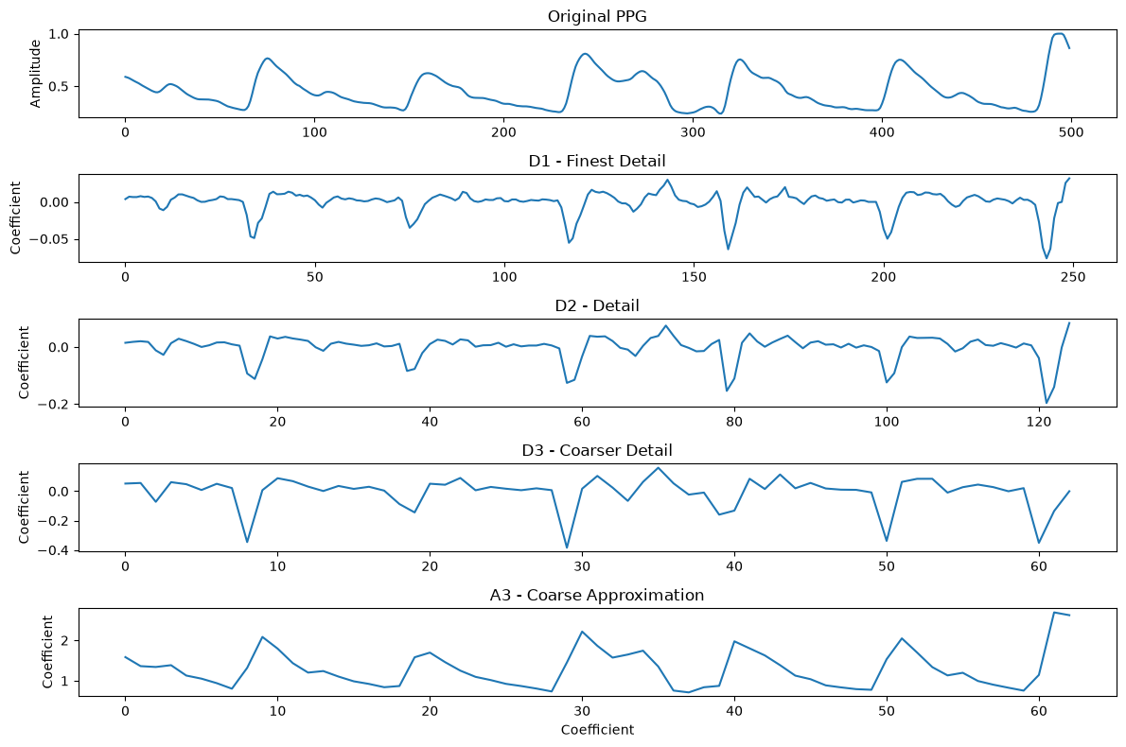
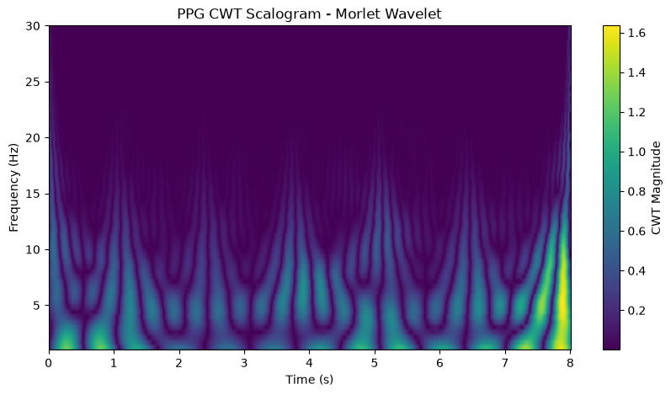
A PPG example: DWT and CWT side by side
PPG
Same signal, two different ways to inspect its structure
DWT: approximation and detail scales
CWT: how activity changes over time and frequency
For this segment, relative energy was concentrated in A3 (99.12%).
The scalogram shows most visible activity at lower frequencies.
Notes:
This is the PPG version of the wavelet analysis. The left plot shows the original PPG plus D1, D2, D3 and A3 coefficients. The right plot shows the PPG CWT scalogram over the eight-second window. In this selected segment, the notebook reports PPG relative energy D1 0.05%, D2 0.20%, D3 0.63%, and A3 99.12%. That is an observation about this segment and selected decomposition, not a universal statement about every PPG signal. The two visualizations answer different questions: DWT summarizes scales, CWT shows how activity is localized in time and frequency.

Slide 20
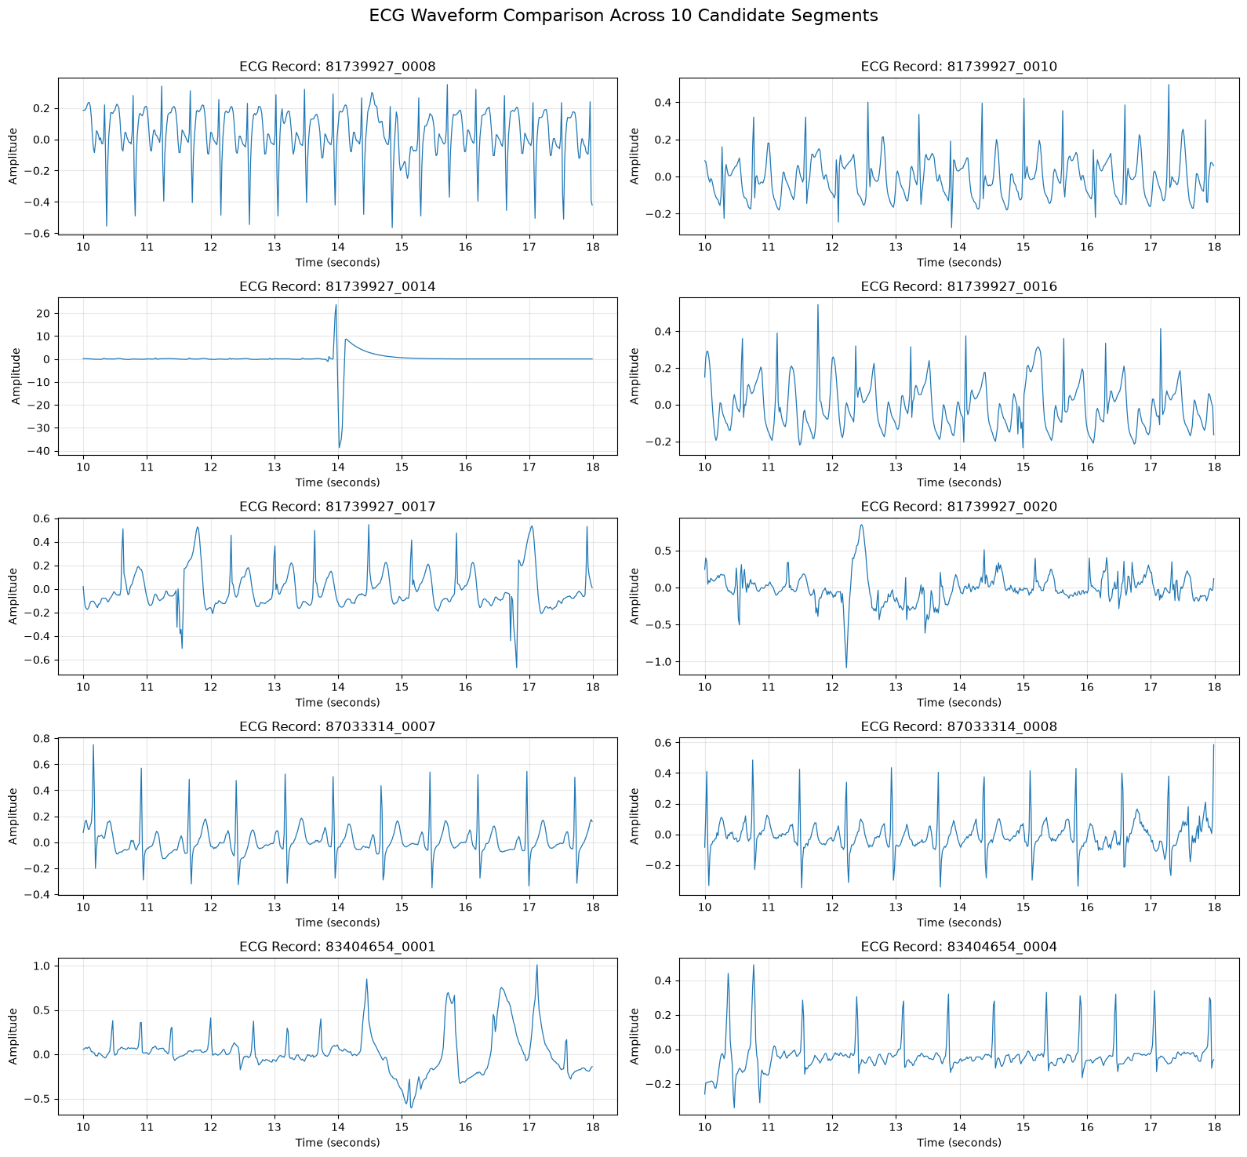
Then we repeated the experiment on 10 candidate records
10-RECORD EXPERIMENT
Same windowing idea, now we can compare different waveform behaviour
10 records
Three folders
Candidate ECG segments were processed.
The list includes records from three subject folders.
Same window
Why scale up?
Each plot shows approximately 10–18 seconds.
A method that looks good on one record may behave differently on another.
One record taught us the method; ten records let us see variation.
Notes:
This is the transition from the prototype to batch analysis. The plots compare ten candidate ECG segments over the selected time interval. They are not ten independent patients; the listed record IDs come from three subject folders and include more than one segment from a folder. Notice how amplitude range, regularity and apparent artifacts vary from record to record. That variation is one reason the single-record result should not be generalized too quickly.

Slide 21
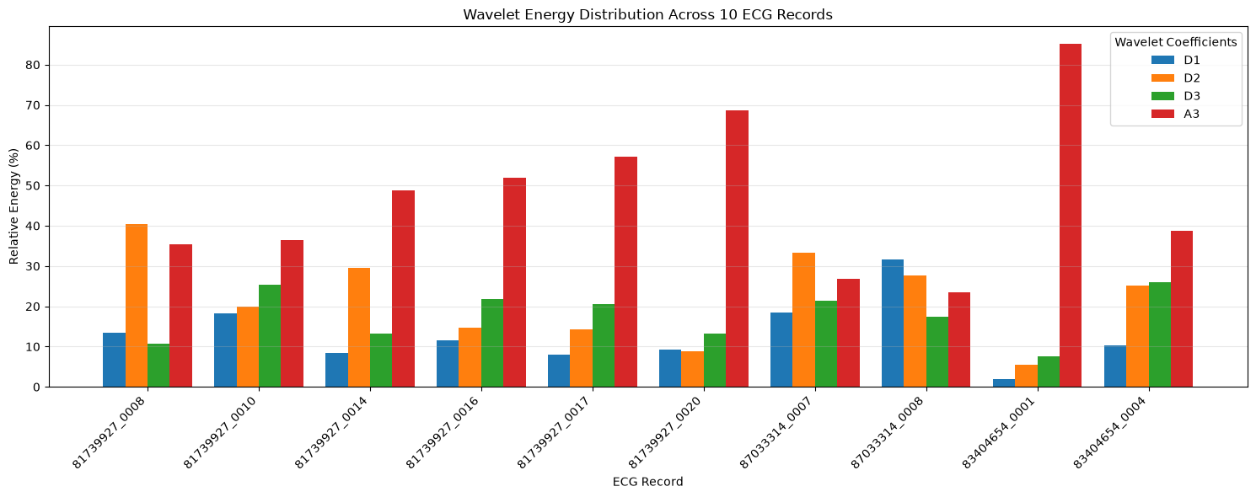
Wavelet energy is not identical across the 10 records
10-RECORD EXPERIMENT
The energy distribution changes from record to record
A3 is often the largest share, but not always. Some records carry a much larger share of energy in D1, D2 or D3.
Notes:
Each grouped set corresponds to one record, and the bars show relative energy for D1, D2, D3 and A3. Several records have A3 as their dominant component, while other records show much larger detail energy. This means we should not describe all records with the single-record percentage values. The plot supports record-to-record variation in scale distribution. The unusually high-amplitude record has a different waveform appearance and should be reviewed along with its metrics.

Slide 22
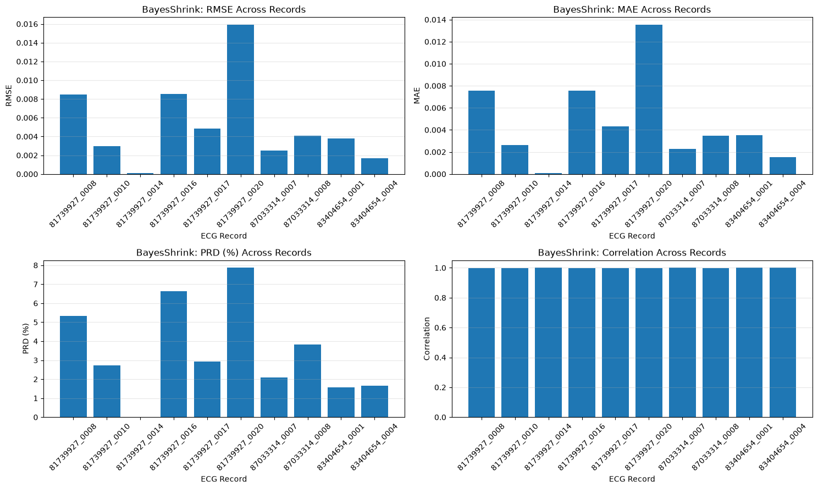
We also checked the metrics record by record
10-RECORD EXPERIMENT
Looking at only the average can hide unusual cases
RMSE and MAE
Show the size of difference from the selected reference.
PRD
Expresses distortion relative to reference signal energy.
Correlation
Useful for waveform similarity, but not sufficient on its own.
Notes:
Explain that the four panels display record-level RMSE, MAE, PRD and correlation for the selected BayesShrink run. A record-level view helps find the outlier that a mean could hide. Correlation bars appear very close to one another on this plot, so if someone asks for exact values, refer to the numeric output table rather than estimating from the chart. These metrics must have a consistent reference, normalization and processing setup to be compared fairly.

Slide 23
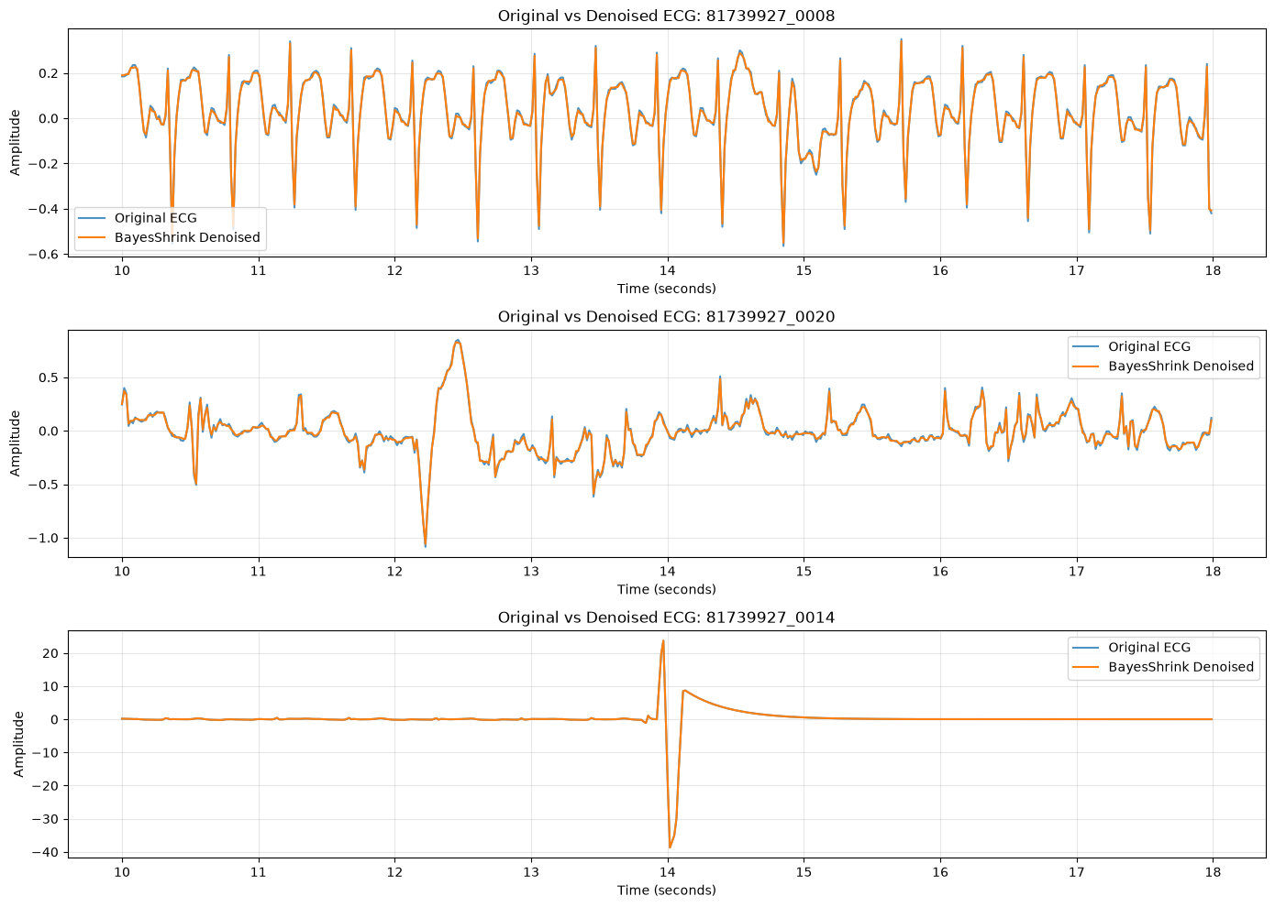
Record 81739927_0014 looked very different
QUALITY CHECK
We flagged it from the waveform, then examined its metrics too
What stands out?
A very large transient near 14 seconds (roughly +24 to −38 in the plotted scale).
Other selected records have much smaller amplitude ranges.
The denoised line follows the transient closely — it does not magically remove it.
A quality flag is a reason to inspect, not proof that the record is wrong.
Next check
Verify units, calibration, artifact/context and how the metrics were normalized.
Notes:
This is the unusual record 81739927_0014. Its waveform includes an extreme transient near 14 seconds, with plotted values roughly +24 and -38, much larger than the rest of the displayed ECG records. The BayesShrink output almost overlays the original, including that large event. Do not call it noise or delete it automatically. It could reflect artifact, scale/calibration differences or a real recorded event; the available plot alone cannot decide. The notebook’s summary values for this record differ substantially from other records, so the correct next step is a quality check and review of the exact metric definitions, not simply accepting or excluding it.

Slide 24
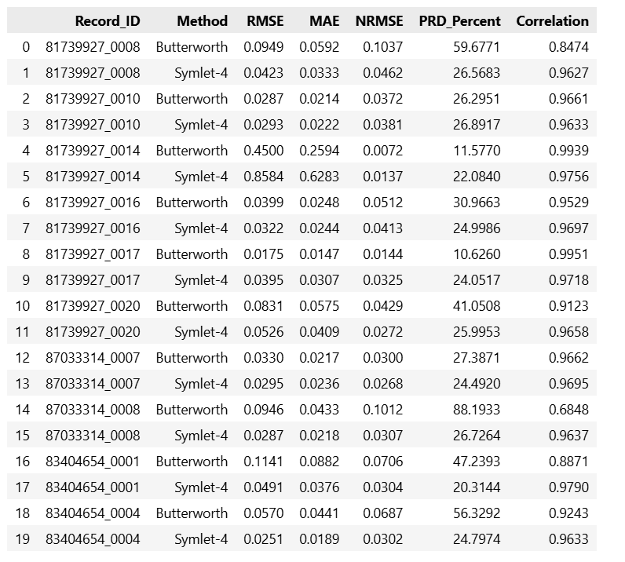
Across 10 records, the winner depends on the case
10-RECORD COMPARISON
We compared Butterworth and Symlet-4 with more than one metric
How to read this table
Each record has a Butterworth row and a Symlet-4 row.
Compare RMSE, MAE, NRMSE, PRD and correlation together.
Symlet-4 is closer by several error measures in multiple records, but it does not win every comparison.
Metrics from different experiments should not be mixed if the noise, threshold or reference differs.
This is a method comparison, not a clinical performance claim.
Notes:
The table compares Butterworth with Symlet-4 for the same set of ten candidate records under this specific output table. The metrics can disagree because they emphasize different properties. For example, lower RMSE means smaller absolute errors relative to the reference; lower PRD means less relative distortion; higher correlation indicates more similar waveform variation. Do not claim Symlet-4 is universally superior: in the separate controlled-noise SNR experiment in the notebook, the average SNR improvements were negative for both Butterworth and Symlet-4, which is a separate protocol and tells us the setup needs consistent evaluation.

Slide 25
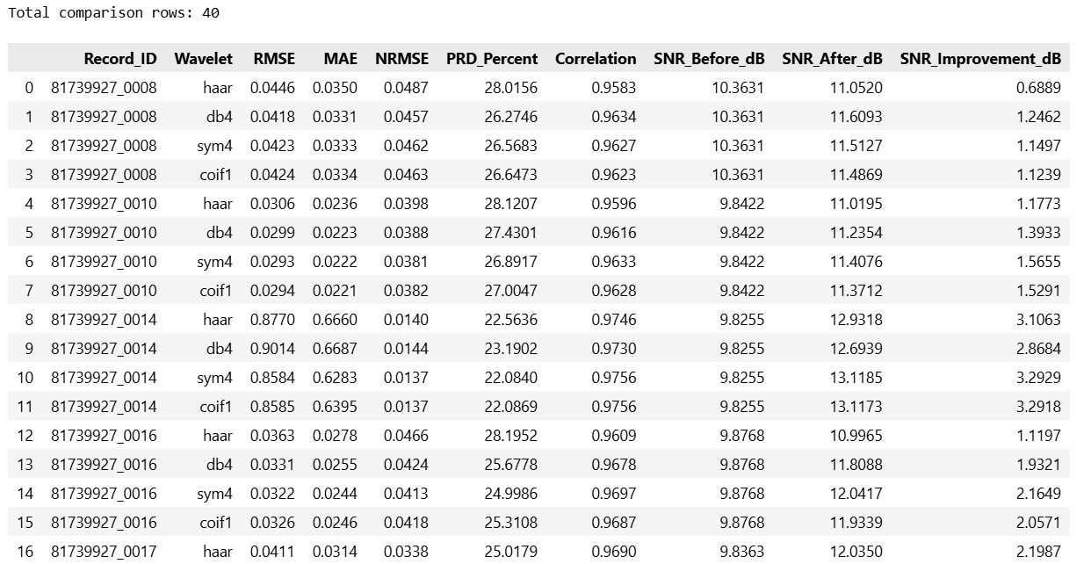
We ran 40 record–wavelet combinations
10-RECORD COMPARISON
Ten records × four wavelet families in the batch table
4 wavelet families
Haar • db4 • sym4 • coif1
40 comparisons
Each candidate record was compared using the four wavelets.
This screenshot is a readable excerpt of the result table; the notebook output contains all 40 rows.
The table helps us compare the methods systematically instead of choosing from one plot.
Notes:
This output table reports forty combinations: ten records and four wavelet families. Each row contains RMSE, MAE, NRMSE, PRD, correlation, SNR before and after, and SNR improvement. The table screenshot here shows an excerpt; the full notebook output has all forty rows. The correct comparison should group metrics by record and method with a consistent protocol. Avoid choosing a “best wavelet” using one attractive result alone.

Slide 26
What did we learn?
CONCLUSION
From one waveform to a small multi-record experiment
ECG and PPG have different waveform shapes and different relative energy distributions.
DWT gives us scale-based coefficients; CWT adds a time-frequency view.
For the selected ECG segment, BayesShrink had lower error and higher correlation than the Butterworth result shown.
All 12 detected peaks stayed at the same positions in that single-record comparison.
The 10-record batch showed record-to-record variation and flagged 81739927_0014 for further quality review.
Main takeaway: a smooth-looking signal is not enough — we need metrics, peak checks, and record-level inspection.
Thankyou!
Notes:
Conclude with the three layers of evidence: the signal description, the per-record denoising metrics and peak positions, and the ten-record comparisons. Be precise: BayesShrink performed well in the selected single-segment comparison, but it is not established as universally better. One record had a major amplitude transient and needs validation. Future work should harmonize the evaluation protocol, verify record metadata and units, and test on more diverse data with more realistic noise and a reliable clean reference when possible.

